Slide 1
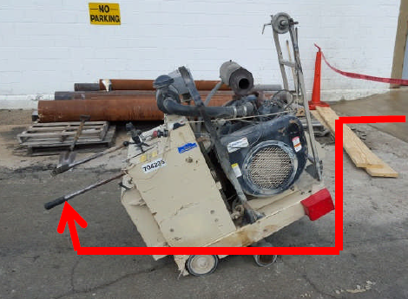

HS&E INCIDENT BULLETIN |  | 2nd half year 2015
New York, USA | Type of incident (Back Strain)
Summary:
Employee was using a Rental Concrete Saw - He had been using the saw for awhile on/off as needed. The saw has controls to move it forward, there is a need to turn the saw to cut in a different position and this has to be done manually - it was during this operation that the millwright felt some pain in his neck and shoulder area.
Root Causes: | Actions Taken Thus Far: Next Steps
Poor posture and lifting, inadequate risk assessment | Construction jobs such as these to be subcontracted out. Re-enforcement of risk assessment process

